Slide 1
Audio Signal Processing
With Python
Part 1 : Installation of required module

Slide 2
Introduction
The following slides try to reproduce the installation of the required module for the audio signal processing using pyaudio
You can use the existing base environment as well

Slide 3
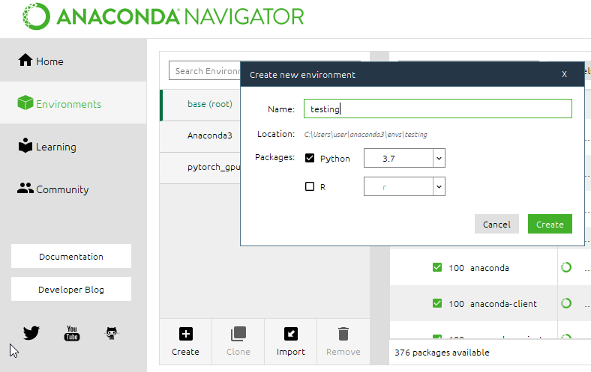
Create a new environment

Slide 4
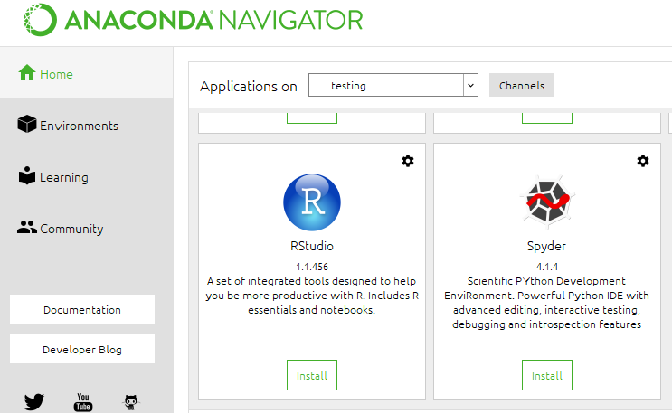
Install Spyder in the testing environment
Then lauch spyder

Slide 5
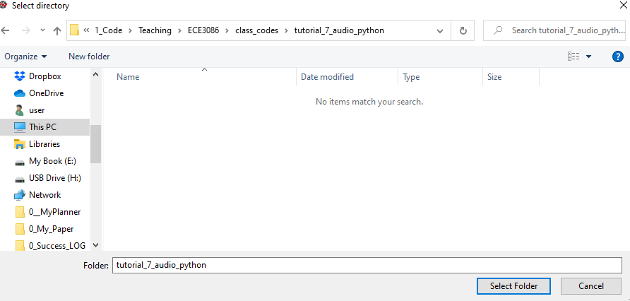
Create a folder to store your code
C:\1_Code\Teaching\ECE3086\class_codes\tutorial_7_audio_python

Slide 6
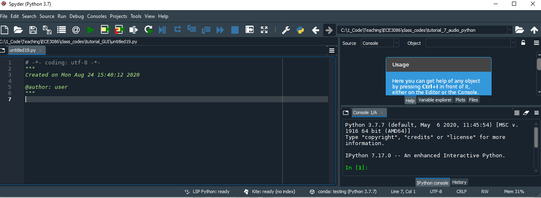
Open Spyder

Slide 7
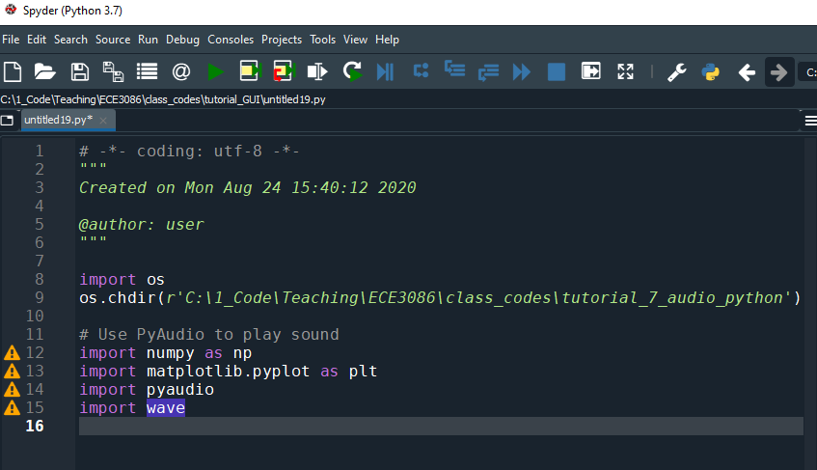
Try import the required module

Slide 8
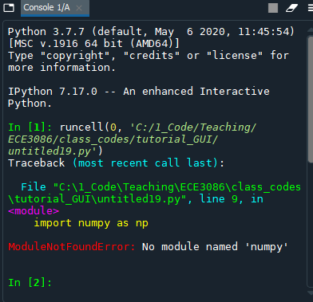
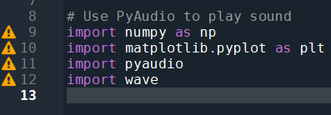
Install numpy
Numpy module is missing , so need to install numpy

Slide 9
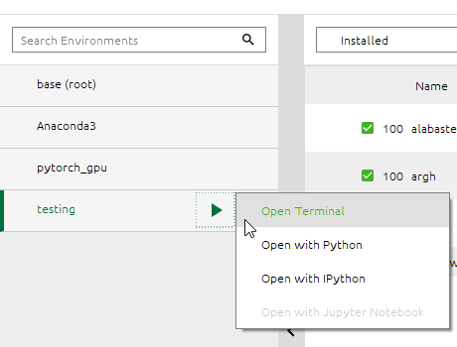
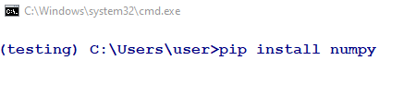
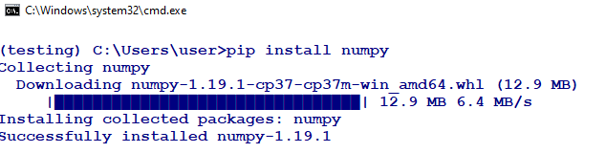
Open terminal

Slide 10
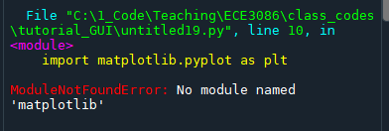
Install matplotlib

Slide 11

Install Pyaudio
Run the import script - import pyaudio

Slide 12
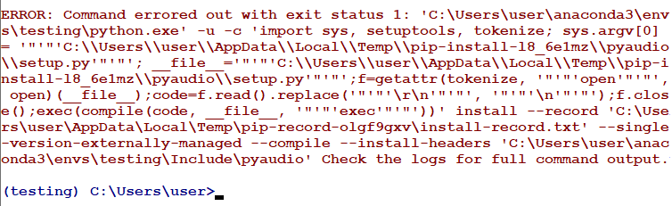
If Fail to install Pyaudio , use alternative

Slide 13
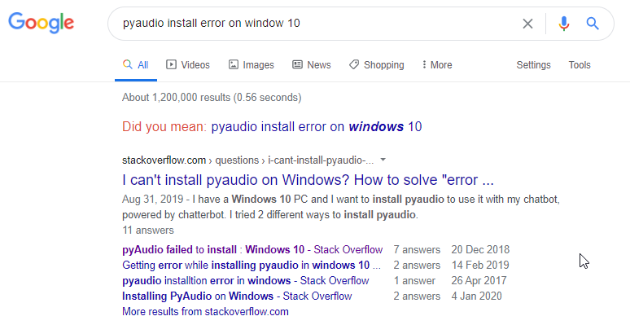
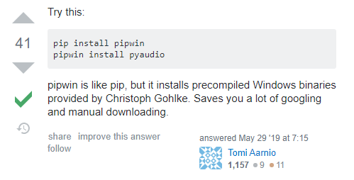
Try Google for answer

Slide 14
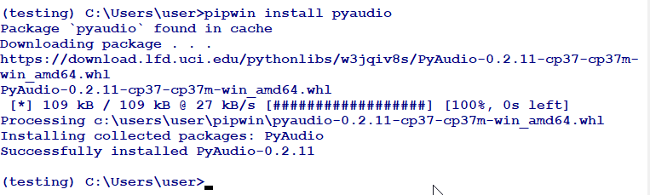
Try the proposed alternative method
It works !!

Slide 15
Install one more - playsound

Slide 17
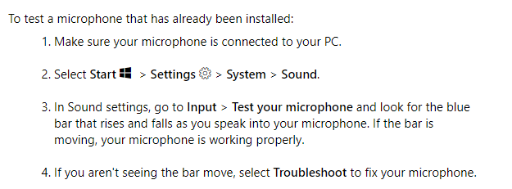
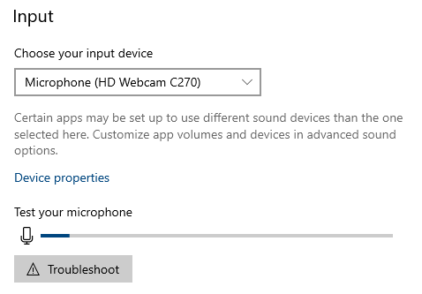
Check microphone
https://support.microsoft.com/en-us/help/4027981/windows-10-how-to-set-up-and-test-microphones

